Slide 1

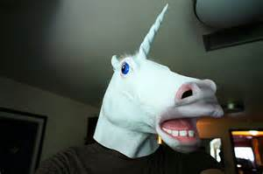


AWESM Stack
Or “Unicorns Really Exist”
@JeremyLikness

Slide 2
Agenda
Who is this guy?
What is so AWESM?
The Parts of the Stack
Q & A

Slide 3
Jeremy Likness
34 years … Writing Software since 1981
21 years … Enterprise Software since 1994
20 years … Web Software since, well, the Web
6 years … Microsoft MVP
4 years … AngularJS since 2011

Slide 4
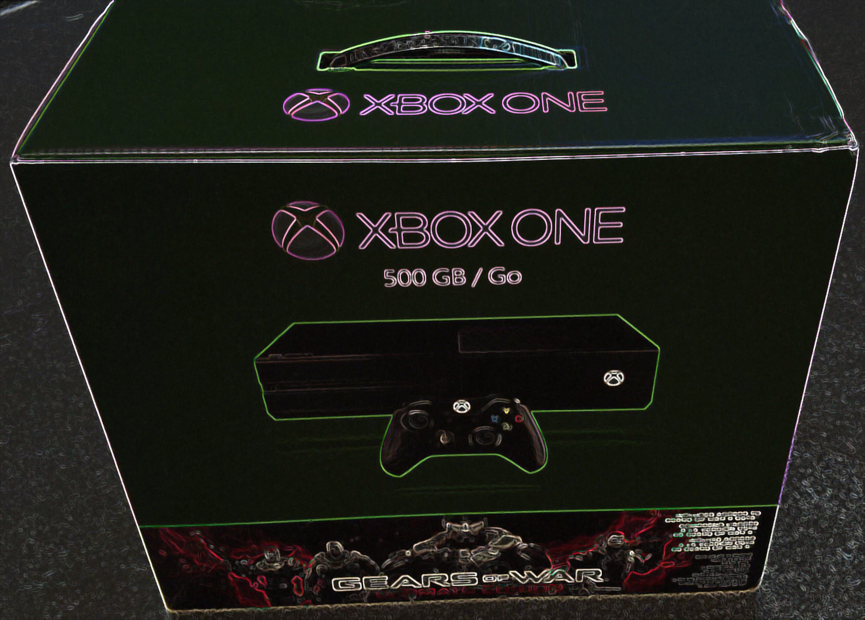
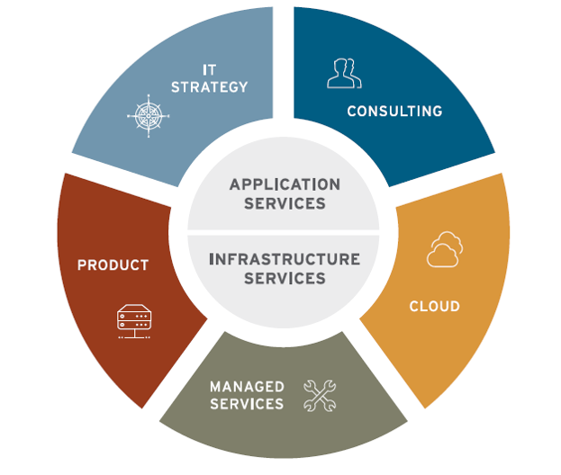
http://bit.ly/ivisionappdev

Slide 5
What is …
AWESM?

Slide 6
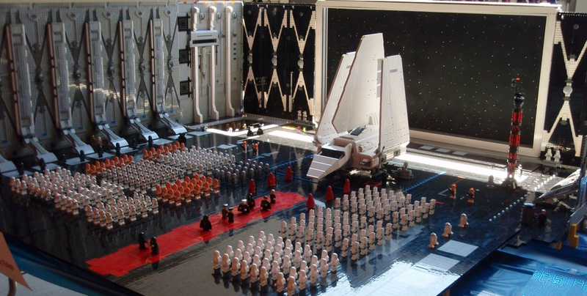
It’s Not AWESM Like a Lego Death Star…

Slide 7
It Is AWESM Like This…
AngularJS
WebAPI (ASP .NET)
Entity Framwork
SQL Server
MVC (ASP .NET)

Slide 8
Case Study #1
80,000
200
25
4
3
Lines of TypeScript Code
Components
Developers
Times Improvement
Years of Development

Slide 9
Case Study #2: In 6 Months (1/3 Complete)
5.5 Million
86,480
43,620
16,712
371
Unique Transactions Tracked in SQL
Lines of SQL Code
Lines of C# Code
Lines of TypeScript Code
Total User Stories

Slide 10
Case Study #3
9,500
300
175
3
1
Office Audits Captured
Integration & Unit Client & Server Tests
Healthcare Providers
Weeks to Build
Developer

Slide 11
What is …
SQL?

Slide 12

SQL is Not AWESM Like a Built-in Dog Carrier

Slide 13
It Is AWESM Like This…
High Performance and Scalability
High Availability
Impressive Security
Immediately Recoverable
Memory and Cloud

Slide 14
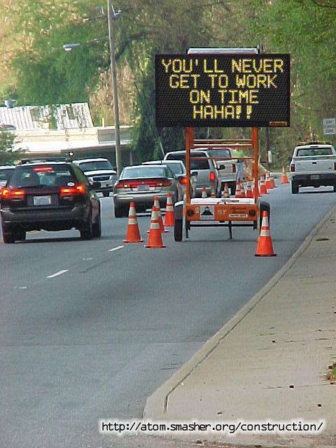
Demo: SQL In the Cloud

Slide 15
What is …
Entity Framework?

Slide 16

EF is Not AWESM Like Chuck Norris vs. Steven Seagal

Slide 17
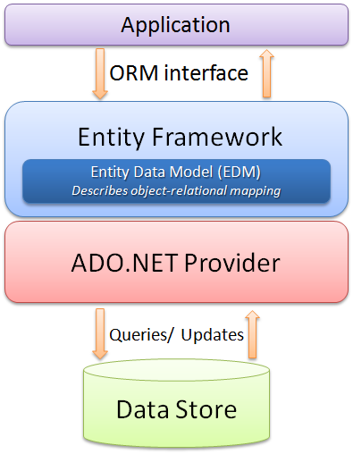
It Is AWESM Like This…
Deal in your Domain
Code First? Data First? Either or Both!
Validation
Speed of Development including Versioning
Flexibility (i.e. Direct Stored Procedure, etc.)

Slide 18
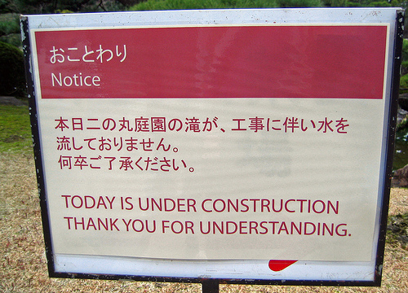
Demo: Entity Framework in Action

Slide 19
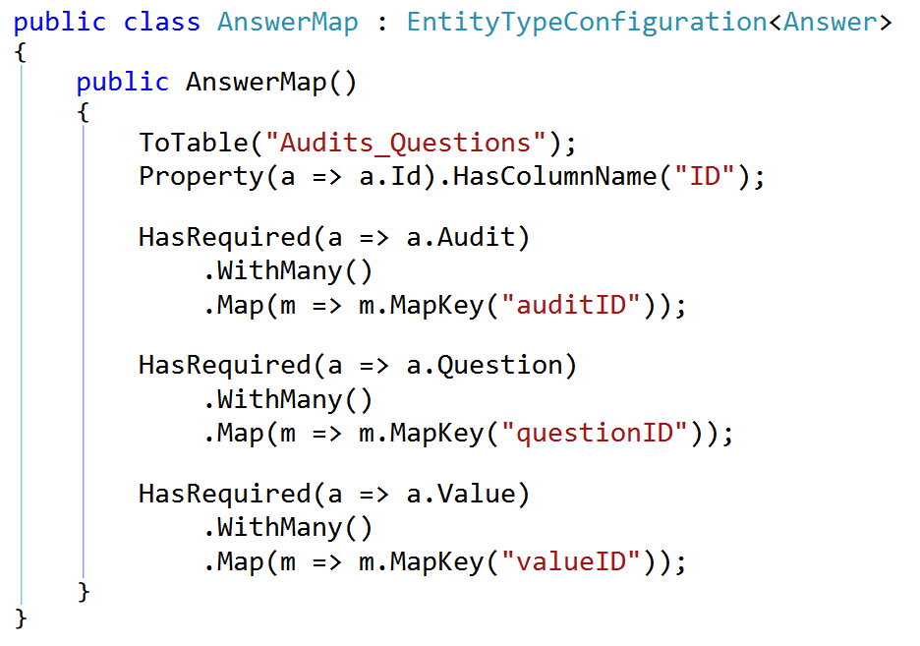
Highly (Fluently) Configurable

Slide 20
What is …
Web API?

Slide 21
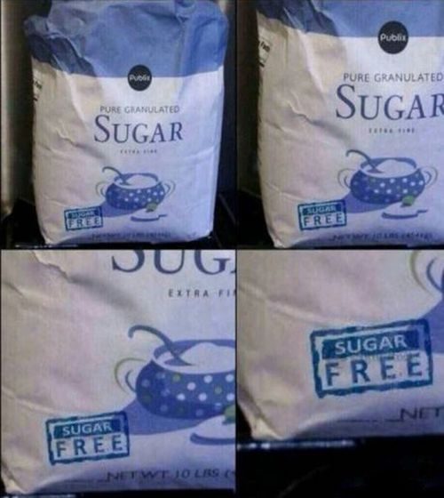
WebAPI is Not AWESM Like Sugar Free Sugar

Slide 22
It Is AWESM Like This…
REST: It’s How Apps Talk™ (OK, just kidding on the Trademark)
JSON (can we put XML to REST already?)
Security
Routing
Behaviors

Slide 23
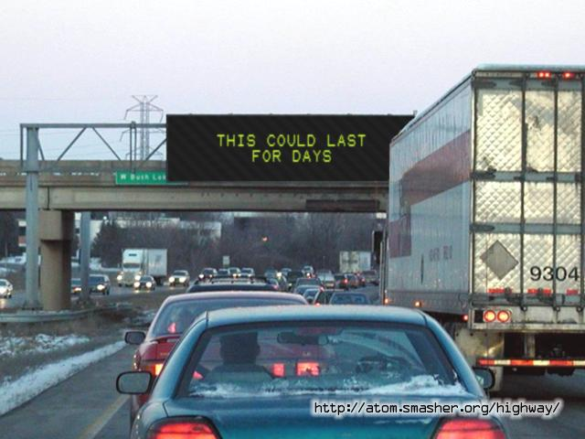
Demo: Web API in Action

Slide 24
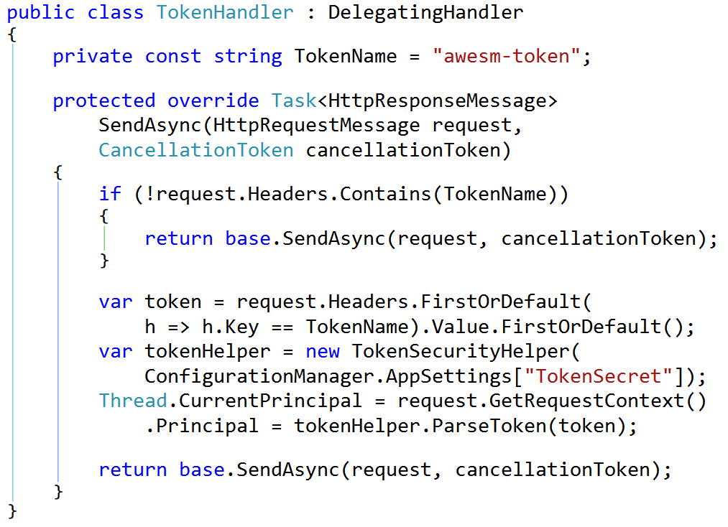
Global Security Management

Slide 25
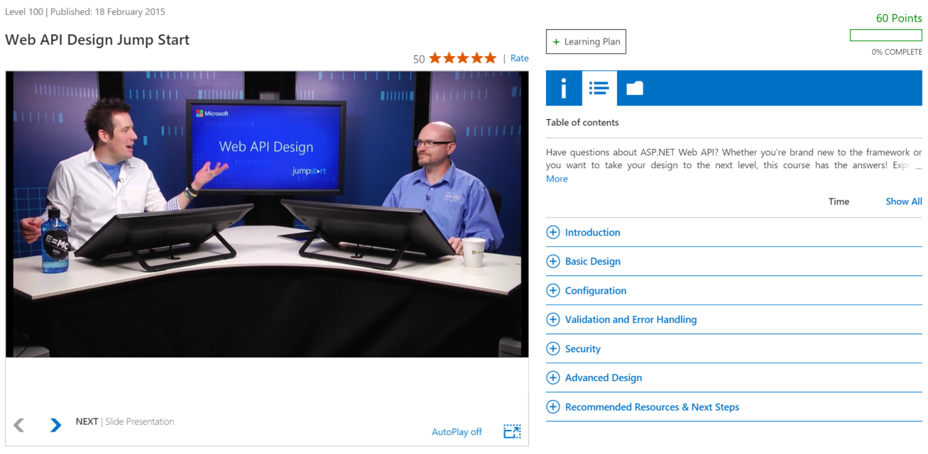
Web API Design Jump Start http://bit.ly/webapimva

Slide 26
What is …
ASP.NET MVC?

Slide 27
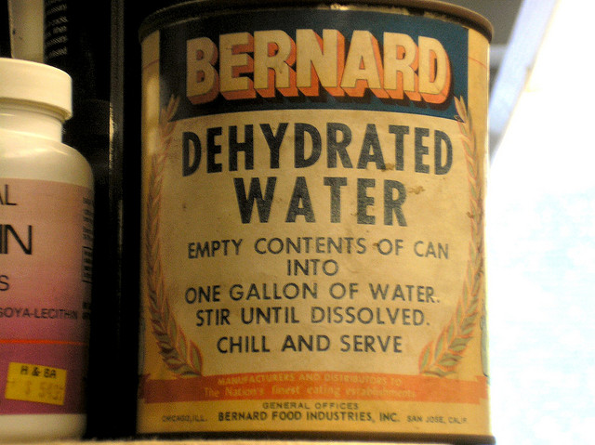
MVC is Not AWESM Like Dehydrated Water

Slide 28
It Is AWESM Like This…
RAZR Engine (or others)
Security
Multi-Lingual
.NET Integration, Logging, and Tracing
Bundling

Slide 29
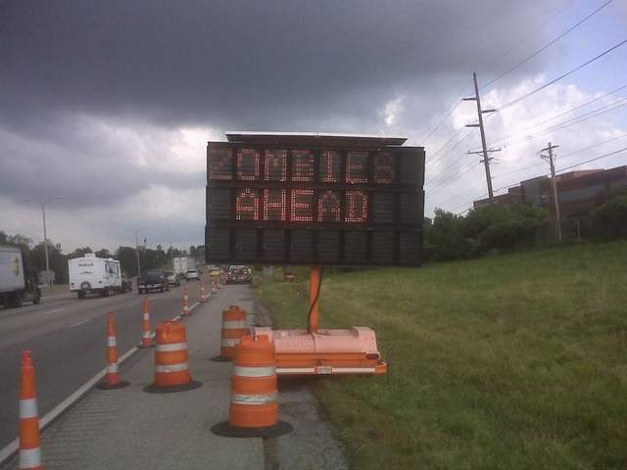
Demo: ASP.NET MVC

Slide 30
What is …
AngularJS?

Slide 31

AngularJS is Not AWESM Like a Ski Mask Beard

Slide 32
It Is AWESM Like This…
Expressions
Data-Binding
Dependency Injection
Tools and Templates
Testing

Slide 33
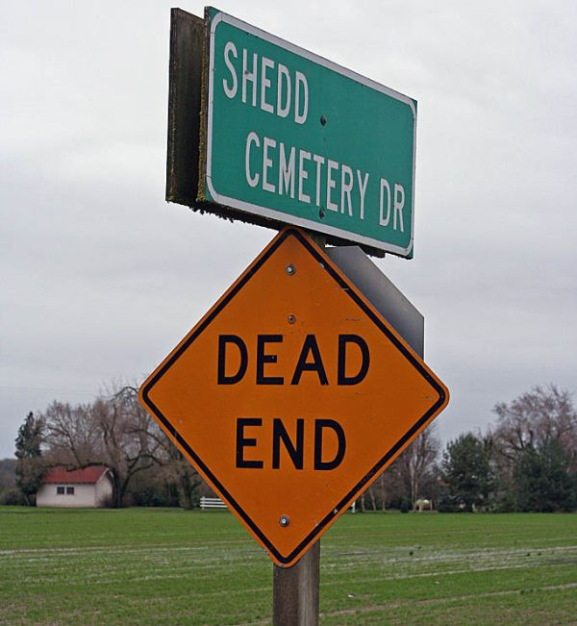
Demo: Hands-on with AngularJS

Slide 34
Questions about the AWESM?
http://bit.ly/coderblog
https://github.com/jeremylikness
http://bit.ly/ivisionappdev
@JeremyLikness

